Slide 1

QA Fundamentals – Course Introduction
Scope, Objective, Target Audience, Schedule
SoftUni Team
Technical Trainers
Software University
http://softuni.bg

Slide 2
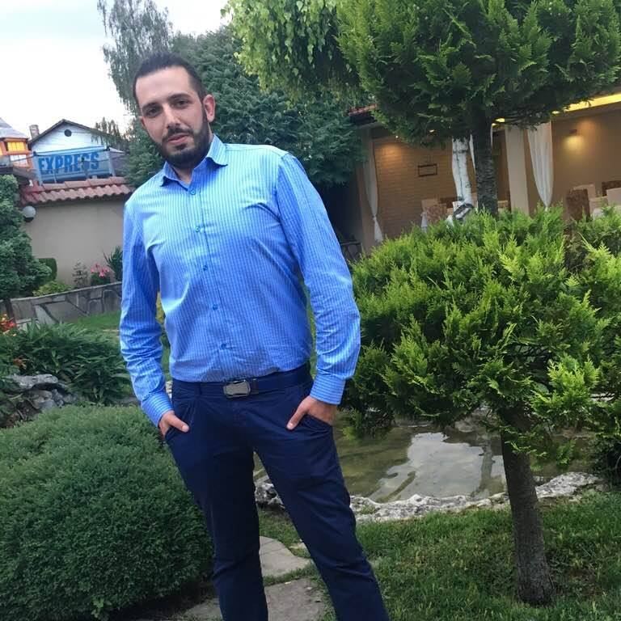
The Trainer
Ventsislav Ivanov
Manual QA
Lecturer at Software University
( Java Fundamentals, C# Fundamentals)
QA Automation – 2 years

Slide 3
You Have Questions?
sli.do #QA-Fund

Slide 4

Table of Contents
Welcome to SoftUni
Course scope
Course objective
Exercises and labs
Examination
Learning resources

Slide 5







Quality Digital Education for Thousands of Young People

Slide 6



Directions at SoftUni
DIGITAL MARKETING
(7 month program)
DESIGN AND CREATIVE
(11 month program)
PROGRAMMING FOR KIDS
( 1- 6 grade)

Slide 7


Directions at SoftUni (2)
“Software University“ Fondation
(free trainings,books and educational content)
Private High School for Digital Skills
(приложно programming, graphic design, digital marketing)

Slide 8

Types of Education
Presently | Online
Direct access to lecturers and assistants | Virtual classroom
Present exercises | Access to training materials
Direct access to colleagues | Contact the lecturer via sli.do
Ability to work in a team

Slide 9
Diploma and Certificates
Diploma for Professions from SoftUni
JavaScript Developer: 80 + credits
PHP Developer: 80 + credits
C# Web Developer: 150 + credits
Java Web Developer: 150 + credits
Each Course at SoftUni gives you several credits
(depends on the difficulty, the scope
of the course and
the evaluation at the end)

Slide 10
Welcome to Software University
Main Program “Software University" @ SoftUni
Quality education, profession and work for software engineers
20 + practical courses, 20 + exams, 15 + exams → ~ 2 years
Work – career center (5.00 + scores)
Free start – each month new course

Slide 11
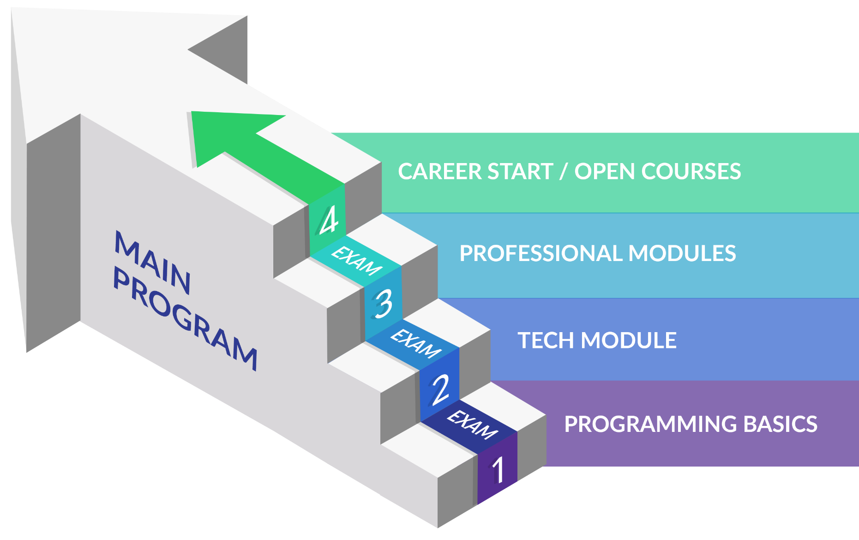
Main Program
C#, Java, PHP, JavaScript

Slide 12
Welcome to Software University
Open Courses @ SoftUni
Quality education, profession and work
Each month new course from different spheres as: Artificial Intelligence, Python, C++, Quality Assurance, Computer Networking, System Administration, Cyber Security Blockchain Technology and etc.

Slide 13
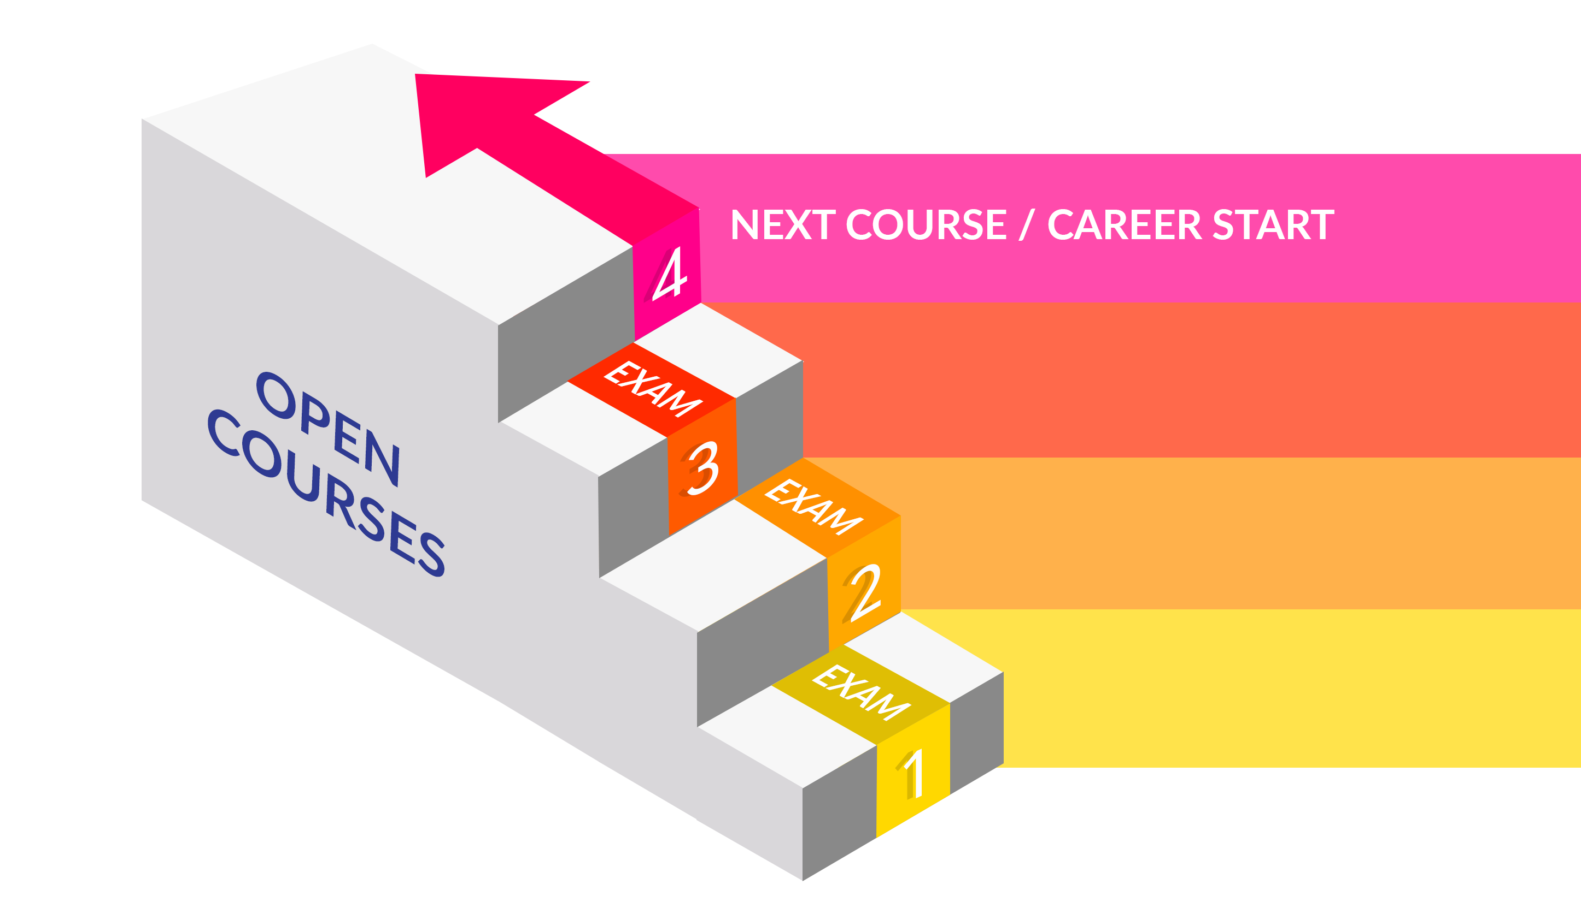
Open Courses
Quality Assurance
QA AUTOMATION
FUNDAMENTALS of PROGRAMMING with C#
QA FUNDAMENTALS

Slide 14
Work for Graduates
SoftUni helps students get started
Contracts with 70 + IT companies for hiring students from
SoftUni
The top students will have the opportunity to work at SoftUni
The top students will choose between a lot of employers
We do not promise work for students with poor results
Career center
Seeks job for everyone with average success 5.00+

Slide 15

Course Scope and Objectives

Slide 16
Course Objectives
Knowledge of the software development process
Knowledge of the QA process
Skills in functional and non-functional testing
Ability to start work as a QA engineer

Slide 17
Course Scope
Course introduction
Introduction to software development and software
testing
Bug tracking systems and reporting issues
Making test cases, scenarios and execution

Slide 18
Course Scope (2)
Reading, examining and writing documentation
Test automation and selenium
Software development and testing lifecycles
Testing types
Practical exam

Slide 19

Exercises and Labs
Why are They Important

Slide 20
Exercises and Labs
Labs - during classes
Exercises - for homework, submitted through the SoftUni.bg
platform up to 1 week after class
Quizzes - during class or up to 2 days after class at
https://softuni.bg:8080

Slide 21

QA Fundamentals: More Details
Duration, Languages, Technologies

Slide 22

Training Duration
Lectures: ~ 20 hours (onsite + YouTube videos)
Practical exercises (in class): ~ 20 hours
Homework: ~ 20-30 hours
Schedule: September – November 2018
Practical exam: 4 November 2018
Practical exam II: ***

Slide 23

Why English?
Why the slides are in English?
English is the native language of the software engineers
Specific terminology should be in English
Translations are inaccurate and funny
Just learn English!
No excuses

Slide 24

QA Fundamentals
Exam and Evaluation Criteria

Slide 25
Practical Exam
The practical exam tests your skills on:
Planning tests
Finding bugs
Reporting issues
Working with a bug tracking system

Slide 26
Practical Exam (2)
Upon given project
Write scenarios
Manually test some of the functionality
Test automation upon given functionalities
Set deployment configuration
Set Bug tracking system workflow
Document all the work (bug reporting, fixing, etc…) in the BTS

Slide 27






Scoring System for Course Name
HOMEWORK
20%
TEAM
PLAY
QUIZZES
BONUSES
10%
EXAM
80%
EVALUATION
CRITERIA

Slide 29
Diamond Partners

Slide 30
Diamond Partners

Slide 31





Trainings @ Software University (SoftUni)
Software University – High-Quality Education, Profession and Job for Software Developers
softuni.bg
Software University Foundation
http://softuni.foundation/
Software University @ Facebook
facebook.com/SoftwareUniversity
Software University Forums
forum.softuni.bg

Slide 32

License
This course (slides, examples, demos, videos, homework, etc.) is licensed under the "Creative Commons Attribution-NonCommercial-ShareAlike 4.0 International" license

